Slide 1
Lecture 0 CSC 112/256 Course Overview
Zonghua Gu
Department of Computer Science
Hofstra University

Slide 2
Course Logistics
Instructor: Dr. Zonghua Gu
Email: Zonghua.Gu@hofstra.edu
Course website: https://guhofstra.github.io/CSC256Fa26/
Lectures: MW 4:20–5:45 PM, SIC 200
Office hours: MW 8:00-9:40 am, SIC 219

Slide 3

Discord Channel and Feedback Form
Join the Discord channel:
https://discord.gg/FAnesZX3p
IMPORTANT! Used for all announcements and online Q&A
Course tutor
Junlin Liao jliao4@pride.hofstra.edu
Available on discord and on-demand ZOOM meetings
Use the anonymous feedback form anytime to provide your comments and suggestions for me.

Slide 4
No Textbook
No required textbook.
Exams are based on lecture slides only
Notes:
Recommended book: Algorithms, 4th Edition by Robert Sedgewick and Kevin Wayne.

Slide 5
Lab Assignments
Two lab assignments
Please sign up on Canvas to form groups of 1-3 students each
Late Days: Each student is allowed a total of 3 late days for this class, which may be spent in units of one day (24 hours) on any project(s) throughout the semester. Once your late days have been used up, late work will not receive any credit. Late days are intended to handle all issues, including unexpected problems such as illness.

Slide 6
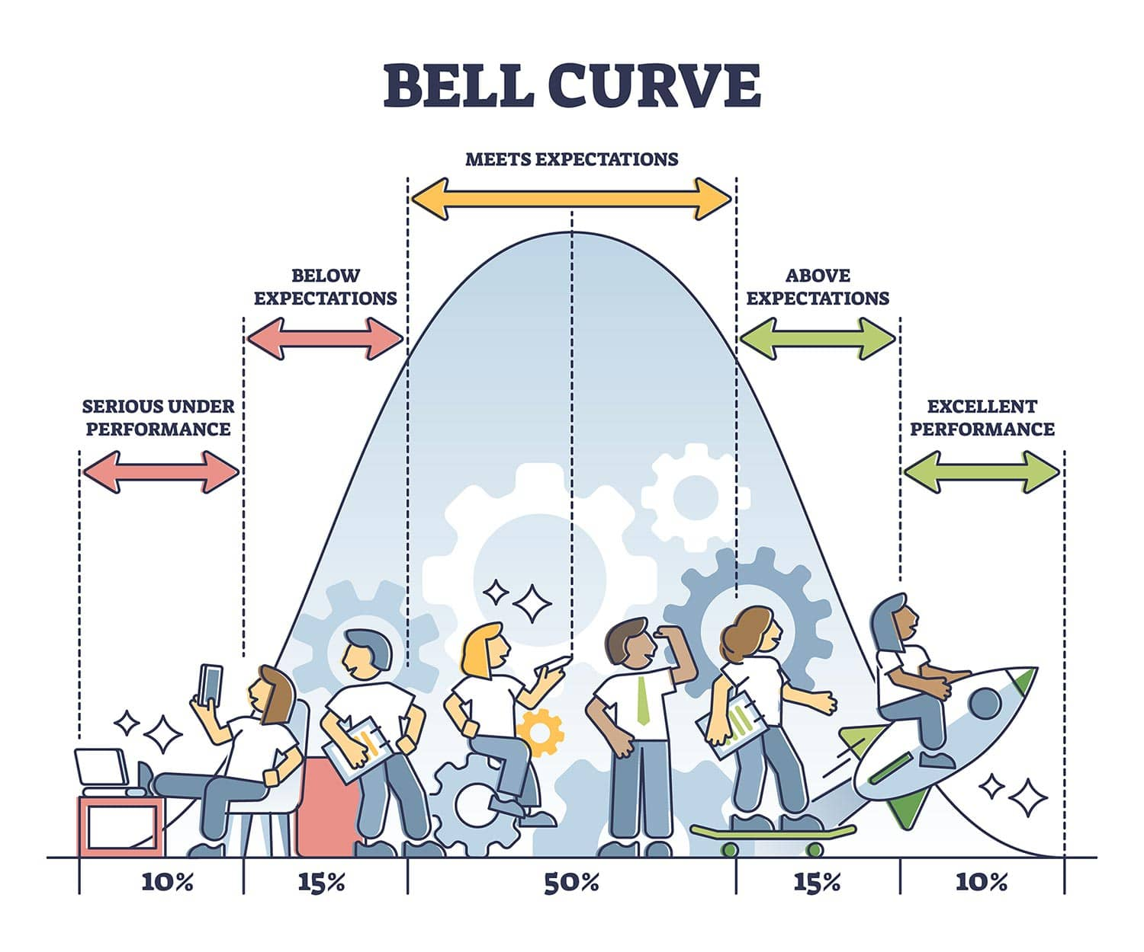
Grading Policy
Midterm exam: 30%
Final exam: 40%
Labs: 30% (10 + 20)
F?
C
B
A
Notes:
https://www.simplypsychology.org/normal-distribution.html

Slide 7
Zoom Option
All lectures will be held both on-site and on Zoom, so you do not need to come to school physically. On-site attendance is encouraged but not required
https://hofstra.zoom.us/j/92794048266
This link is also available in Canvas.
Zoom recordings will be available in Kaltura Course Gallery in Canvas

